Slide 1
MACHINE LEARNING
Session – 1
Date – 07th June, 2022

Slide 2
What is Python?
Python programming language is a general purpose high level language which is structural, procedural, and object oriented programming. Like most programming languages, Python code supports classes, methods, static methods, inheritance, etc. And the most important part is, it supports modules and packages which encourages code reusability in a program work flow.

Slide 3
Why Learn Python programming language?
Here are some of the reasons but not limited to learn Python programming language.
It is very popular, probably because it’s easy to learn code for beginners.
It has a simple syntax (like a spoken language) which makes people understand without putting much effort. Because of this, newbies can quickly start working on simple programs or even understand the complex codes written by professionals.
This is the most versatile language I have ever come across. Because we can use it for the script purpose, web development, data analysis, reporting, and many more.
Its open source (free) and it support cross platform that means you can run this on Mac, Windows, Linux, and the other platforms as well.
Use this Python language to develop both windows and web applications.
The kind of resources that it has, including tutorials, forums, libraries that support this python development environment is unimaginable.
Moreover, it has large variety of libraries or python modules that support Data Scientists to analyze and visualize tutorial data.
Because of all the above features, Python interpreter helps for the rapid application development.

Slide 4
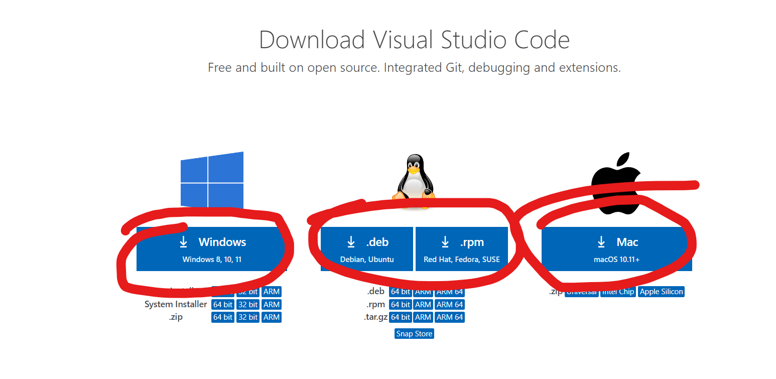
Resources
Download Python - Download Python | Python.org
Download VS Code - Download Visual Studio Code - Mac, Linux, Windows (Click on windows icon to download it

Slide 5
Python Basics
Variables
Global Variables
Local Variables
Datatypes
Type Conversion
Random Numbers
Download Library
Pip (Pip Installs Packages)
String Modification (String Methods, Formatted string)

Slide 6
Python Variables
Variable is a name that is used to refer to memory location. Python variable is also known as an identifier and used to hold value.
In Python, we don't need to specify the type of variable because Python is a infer language and smart enough to get variable type.
Variable names can be a group of both the letters and digits, but they have to begin with a letter or an underscore.
It is recommended to use lowercase letters for the variable name. Rahul and rahul both are two different variables.

Slide 7
Identifier Naming
Variables are the example of identifiers. An Identifier is used to identify the literals used in the program. The rules to name an identifier are given below.
The first character of the variable must be an alphabet or underscore ( _ ).
All the characters except the first character may be an alphabet of lower-case(a-z), upper-case (A-Z), underscore, or digit (0-9).
Identifier name must not contain any white-space, or special character (!, @, #, %, ^, &, *).
Identifier name must not be similar to any keyword defined in the language.
Identifier names are case sensitive; for example, my name, and MyName is not the same.
Examples of valid identifiers: a123, _n, n_9, etc.
Examples of invalid identifiers: 1a, n%4, n 9, etc.

Slide 8
Declaring Variable and Assigning Values
Python does not bind us to declare a variable before using it in the application. It allows us to create a variable at the required time.
We don't need to declare explicitly variable in Python. When we assign any value to the variable, that variable is declared automatically.
The equal (=) operator is used to assign value to a variable.

Slide 9
Object References
It is necessary to understand how the Python interpreter works when we declare a variable. The process of treating variables is somewhat different from many other programming languages.
Python is the highly object-oriented programming language; that's why every data item belongs to a specific type of class. Consider the following example.
print("John")
The Python object creates an integer object and displays it to the console. In the above print statement, we have created a string object. Let's check the type of it using the Python built-in type() function.
type("John")
In Python, variables are a symbolic name that is a reference or pointer to an object. The variables are used to denote objects by that name.

Slide 10
Multiple Assignment
Assigning single value to multiple variables:
x=y=z=50
2. Assigning multiple values to multiple variables:
a,b,c=5,10,15
The values will be assigned in the order in which variables appear.

Slide 11
Local Variable
Local variables are the variables that declared inside the function and have scope within the function. Let's understand the following example.
# Declaring a function
def add():
# Defining local variables. They has scope only within a function
a = 20
b = 30
c = a + b
print("The sum is:", c)
# Calling a function
add()
In the above code, we declared a function named add() and assigned a few variables within the function. These variables will be referred to as the local variables which have scope only inside the function. If we try to use them outside the function, we get an error.

Slide 12
Global Variables
Global variables can be used throughout the program, and its scope is in the entire program. We can use global variables inside or outside the function.
A variable declared outside the function is the global variable by default. Python provides the global keyword to use global variable inside the function. If we don't use the global keyword, the function treats it as a local variable. Let's understand the following example.
x = 101
# Global variable in function
def mainFunction():
# printing a global variable
global x
print(x)
# modifying a global variable
x = ’Hello World’
print(x)
mainFunction()
print(x)
In the above code, we declare a global variable x and assign a value to it. Next, we defined a function and accessed the declared variable using the global keyword inside the function. Now we can modify its value. Then, we assigned a new string value to the variable x.

Slide 13
Delete a variable
We can delete the variable using the del keyword. The syntax is given below.
Syntax
del <variable_name>
In the following example, we create a variable x and assign value to it. We deleted variable x, and print it, we get the error "variable x is not defined". The variable x will no longer use in future.
x = 6
# deleting a variable.
del x
print(x) #will throw error

Slide 14
Type Conversion in Python
Python defines type conversion functions to directly convert one data type to another which is useful in day-to-day and competitive programming. This article is aimed at providing information about certain conversion functions.
There are two types of Type Conversion in Python:
Implicit Type Conversion
Explicit Type Conversion

Slide 15
Implicit Type Conversion
In Implicit type conversion of data types in Python, the Python interpreter automatically converts one data type to another without any user involvement.
Explicit Type Conversion
In Explicit Type Conversion in Python, the data type is manually changed by the user as per their requirement. Various forms of explicit type conversion are explained below:
1.int(a, base): This function converts any data type to integer. ‘Base’ specifies the base in which string is if the data type is a string. 2. float(): This function is used to convert any data type to a floating-point number3. ord() : This function is used to convert a character to integer. 4. hex() : This function is to convert integer to hexadecimal string. 5. oct() : This function is to convert integer to octal string.
6. tuple() : This function is used to convert to a tuple. 7. set() : This function returns the type after converting to set. 8. list() : This function is used to convert any data type to a list type.
9. dict() : This function is used to convert a tuple of order (key,value) into a dictionary. 10. str() : Used to convert integer into a string. 11. complex(real,imag) : This function converts real numbers to complex(real,imag) number.
12. chr(number): This function converts number to its corresponding ASCII character.

Slide 16
Python Random Module
Python Random module is an in-built module of Python which is used to generate random numbers. These are pseudo-random numbers means these are not truly random. This module can be used to perform random actions such as generating random numbers, print random a value for a list or string, etc.
Example: Printing a random value from a list
import random
# prints a random value from the list
list1 = [1, 2, 3, 4, 5, 6]
print(random.choice(list1))

Slide 17
Creating Random Integers
random.randint() method is used to generate random integers between the given range.
Syntax :
randint(start, end)
Example: Creating random integers
import random
# Generates a random number between 5 and 15
r1 = random.randint(5, 15)
print(f"Random number between 5 and 15 is {r1}“)

Slide 18
Creating Random Floats
random.random() method is used to generate random floats between 0.0 to 1.
Syntax:
random.random()
Example:
import random
# Prints random item
print(random())

Slide 19
Selecting Random Elements
random.choice() function is used to return a random item from a list, tuple, or string.
Syntax:
random.choice(sequence)
Example:
import random
list1 = [1, 2, 3, 4, 5, 6]
print(random.choice(list1))

Slide 20
Shuffling List
random.shuffle() method is used to shuffle a sequence (list). Shuffling means changing the position of the elements of the sequence. Here, the shuffling operation is inplace.
Syntax:
random.shuffle(sequence, function)
Example:
import random
# declare a list
sample_list = [1, 2, 3, 4, 5]
print("Original list : ")
print(sample_list)
# first shuffle
random.shuffle(sample_list)
print(f"After the first shuffle : {sample_list}")

Slide 21
Python - Modify Strings
str1 = ' hello World '
print(f"Original String - '{str1}'")
print(f"String in all upper case characters - '{str1.upper()}'")
print(f"String in all lower case characters - '{str1.lower()}'")
#we have a strip() in string which we use for removing extra spaces from
# left of starting character and to the right of ending character
print(f"String after removing extra spaces from left and right '{str1.strip()}'")
#to replace any character with other in a string we use replace()
print(f"String after replace h with y '{str1.replace('h','y')}’”)
#to split a string into subtring on a character
str2 = "Hello,How, are,you"
print(f"String after splitting on comma(,) = '{str2.split(',')}'") #by default it splits from space

